Slide 1
CHANDIDAS MAHAVIDYALAYA
DEPARTMEANT OF GEOGRAPHY
Topic.- Urban hierarchies
Prof.- Indrajit Mandal

Slide 3
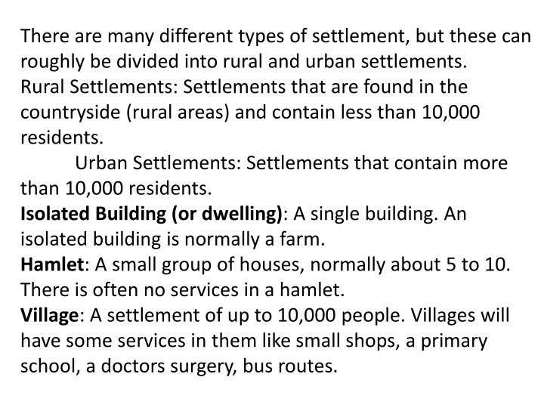

Slide 4
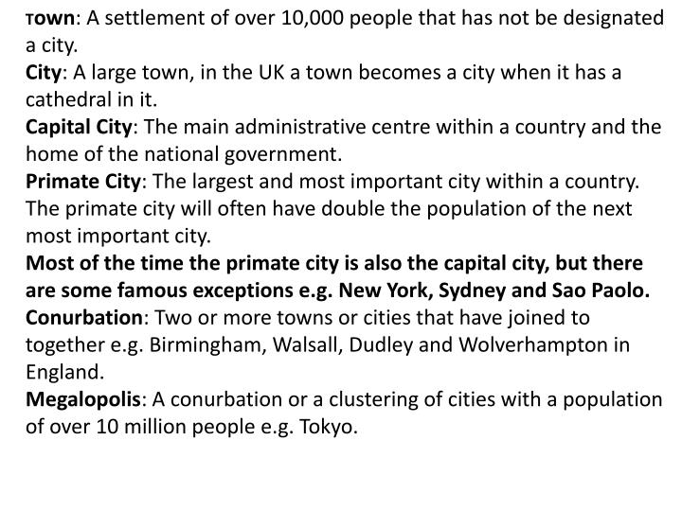

Slide 5
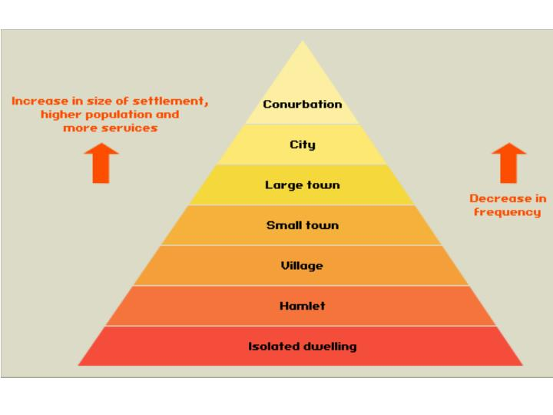

Slide 13
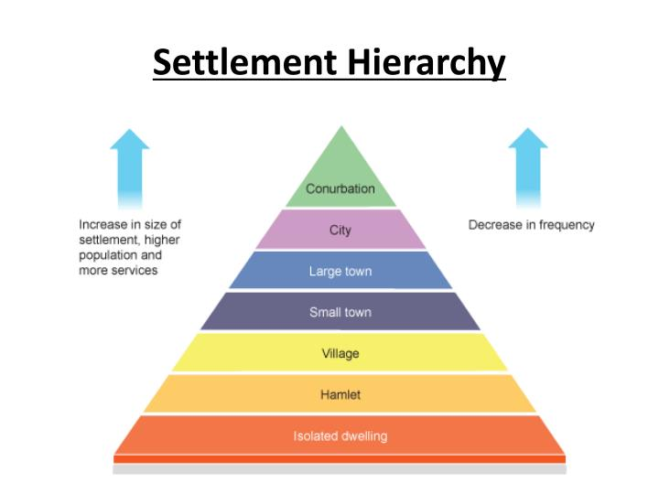

Slide 14
Thank you

